Slide 1
Agenda
MicroStrategy Architecture
2-Tier
3-Tier
4-Tier

Slide 2
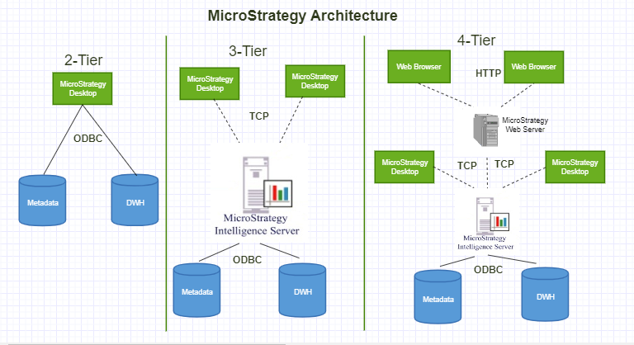

Slide 3
2-Tier Architecture
Metadata
ODBC to Metadata
MicroStrategy
DWH
ODBC to DWH

Slide 4
3-Tier Architecture
Metadata
MicroStrategy
Intelligent Server
TCP
ODBC
MicroStrategy
DWH

Slide 5
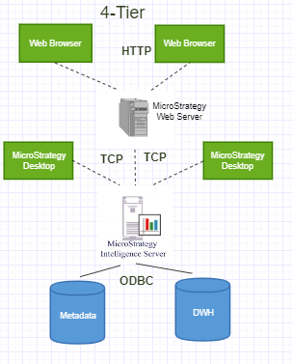
4-Tier Architecture

